Slide 1
Analyzing Used Car data from CarsGuru
Presented By: Andrew Rosalino, Andrew Tran, Edgar Manukian, Thomas Lew, Brian Sangalang

Slide 2



Project Overview
We will be analyzing a dataset that pulled data off of Carsguru’s inventory from September 2020
Loading the data into Hadoop, filtering and storing with Hive, and analyzing using PowerBi
Dataset Link: https://www.kaggle.com/ananaymital/us-used-cars-dataset (2GB compressed, 8GB uncompressed)
Also hosted on our AWS server: https://cis4560.s3.us-east-2.amazonaws.com/archive.zip
Can also be found on our Github: https://github.com/aylmaokai/CIS4560

Slide 3
H/W Specifications
Cluster Version: 2.7.1
Cluster Number of Nodes: 3
Memory Size: 180 GB
CPU Speed: 2195 MHz

Slide 4
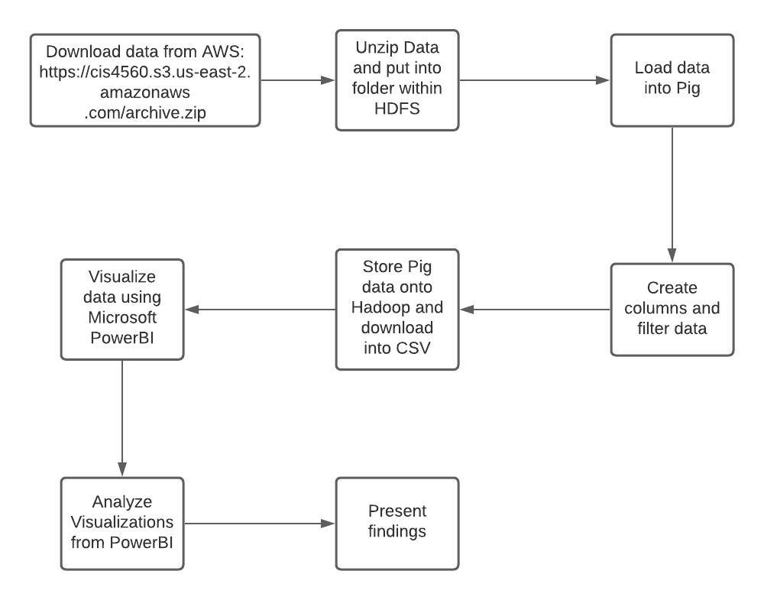
Workflow Chart

Slide 5
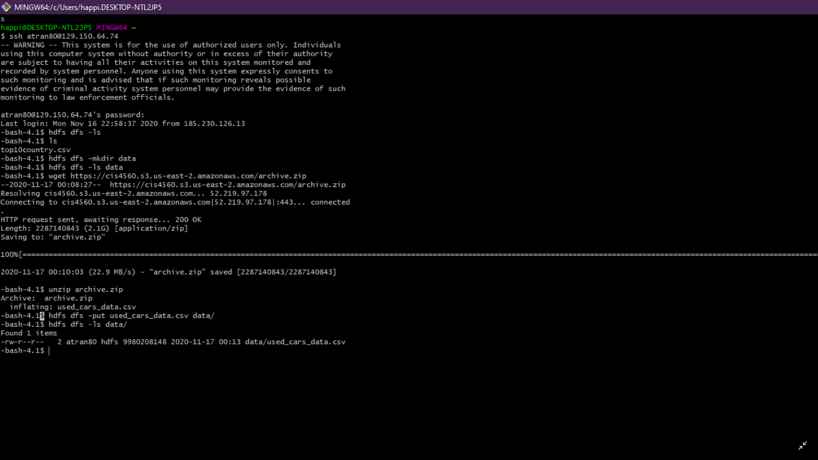
Download and Unzip data from AWS

Slide 6
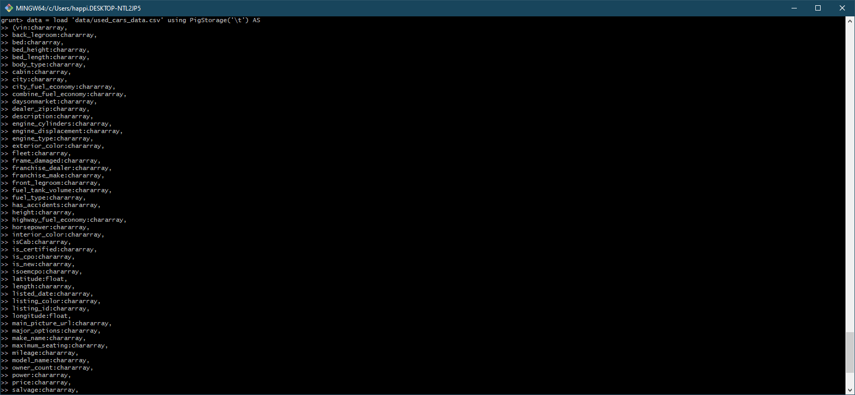
Enter Pig and load data & define columns

Slide 7
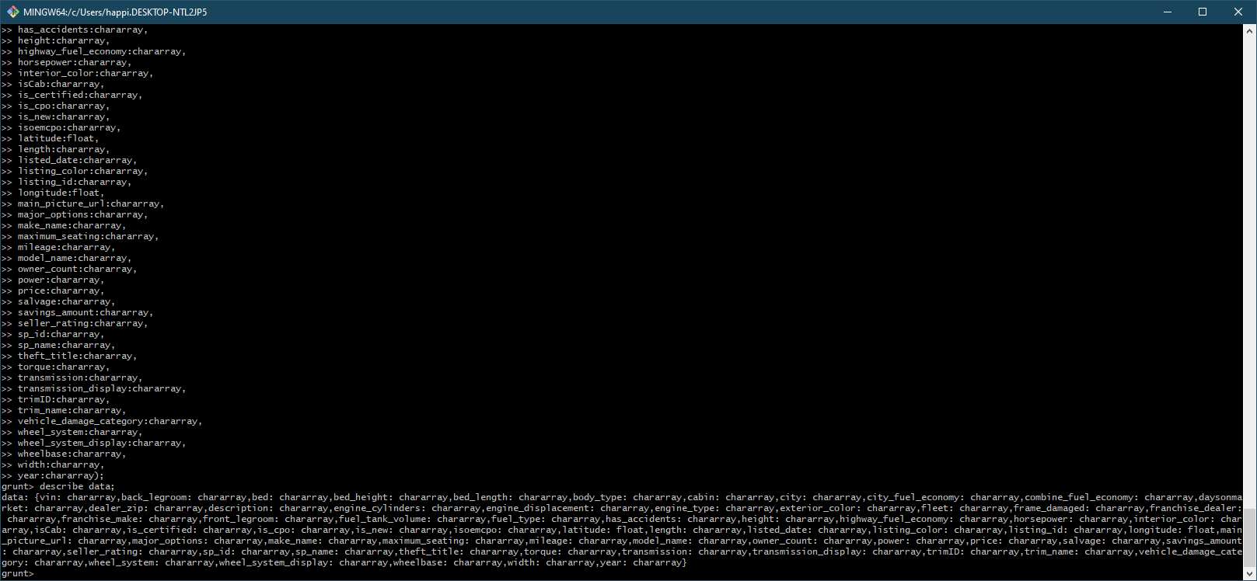
Describe car data

Slide 8
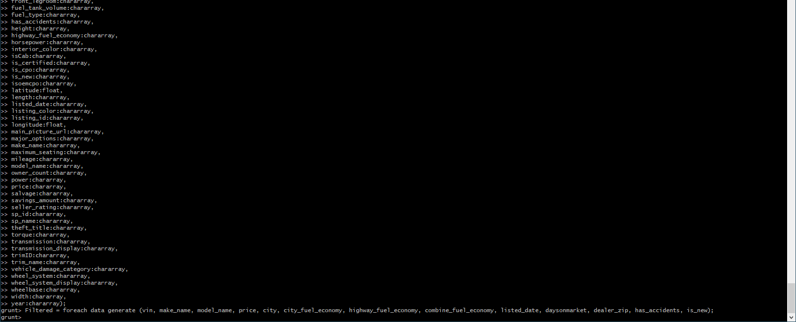
Filter the data so that only relevant columns are shown.

Slide 9
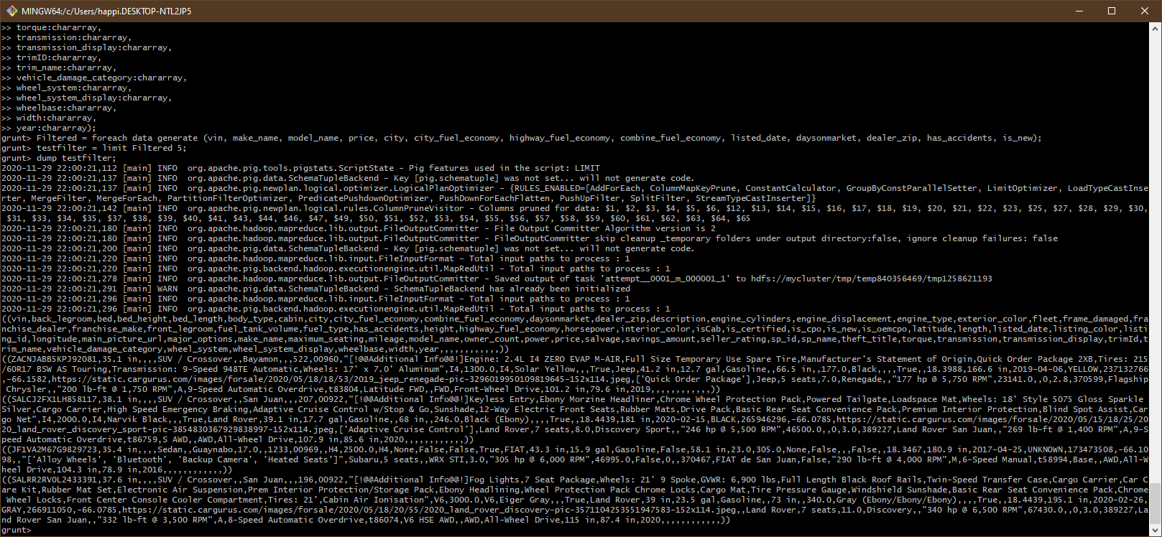
Test the data using a DUMP command with a limit on it

Slide 10
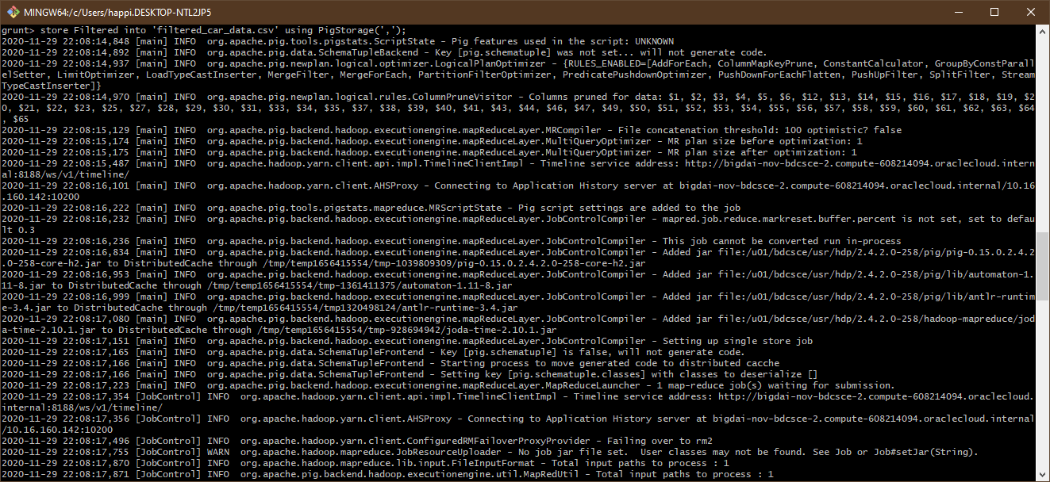
Store Filtered into ‘filtered_car_data.csv’ using PigStorage(‘,’);

Slide 11
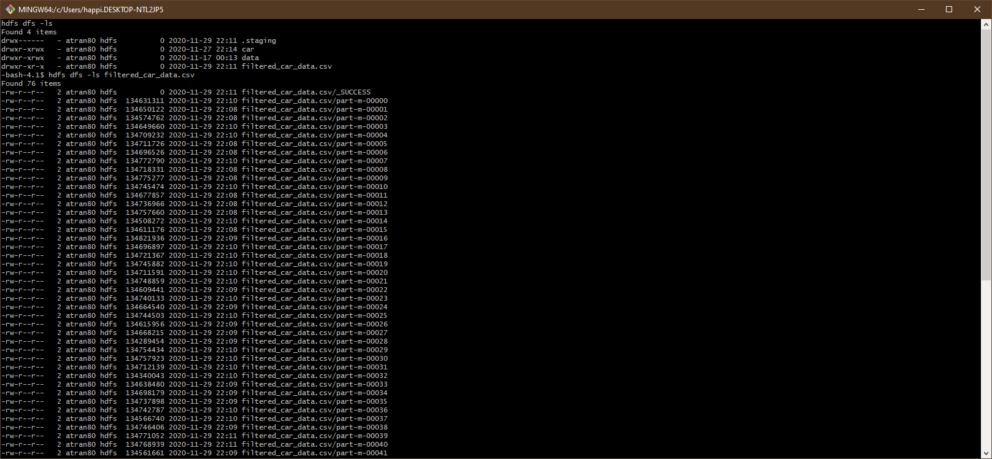
Check if the file is present and has data in it in Hadoop.

Slide 12
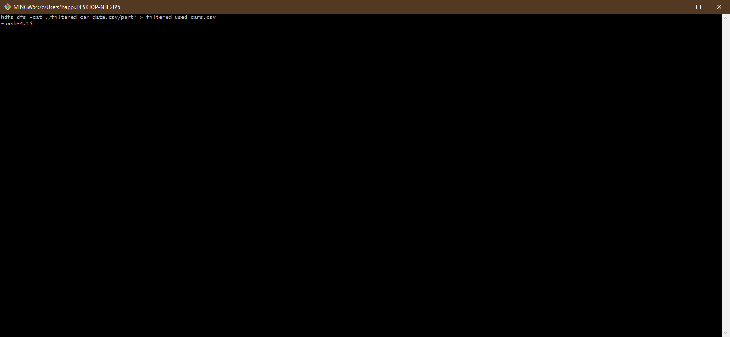
Convert the Pig results into a CSV.

Slide 13
Download the newly created and filtered csv using SCP

Slide 14
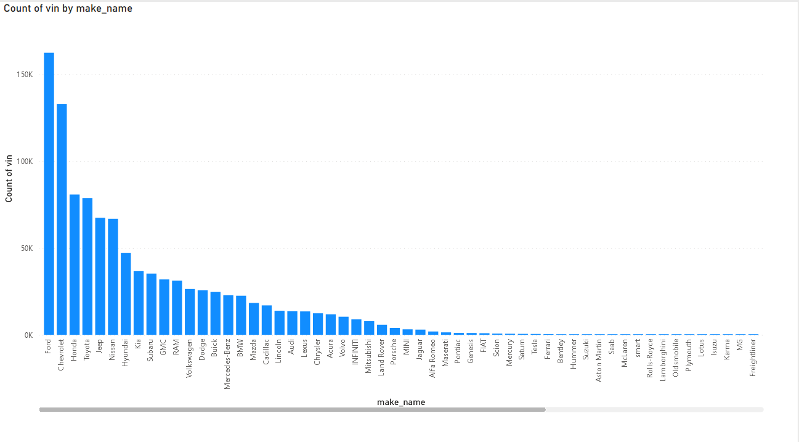
Top used cars (PowerBI)
Top 3 used cars are Ford, Chevrolet, and Honda.

Slide 15
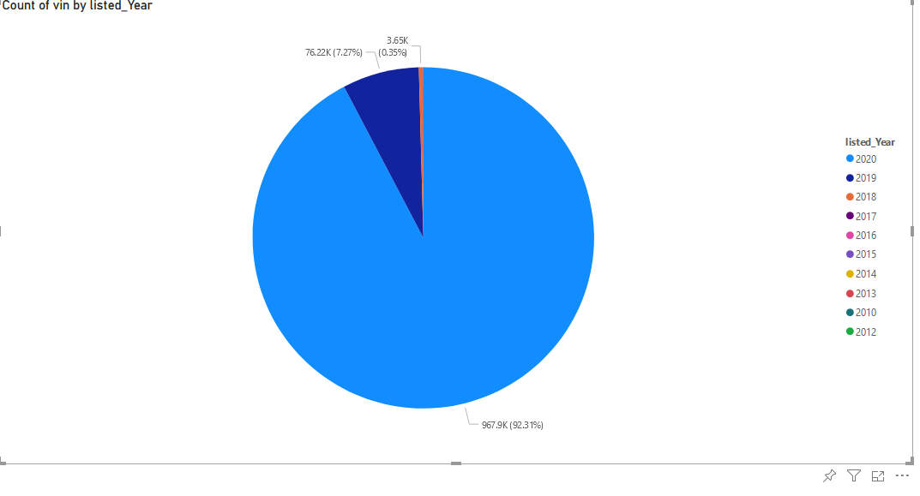
Used cars by year (PowerBI)
2020 Saw an enormous uptick in used car listings. COVID-19 could be a contributing factor.

Slide 16
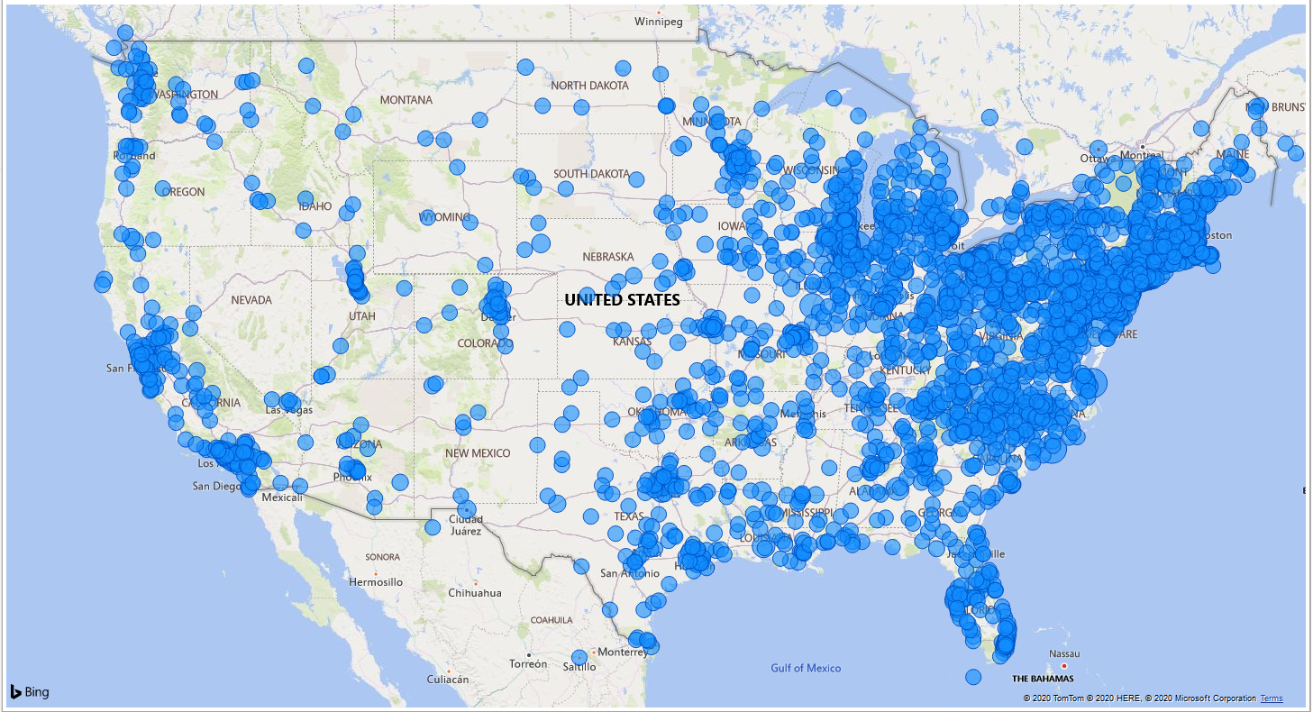
Geomap (PowerBI)
Most used cars are found in the eastern coast of the United States. CarGurus is located in the east coast however.

Slide 17
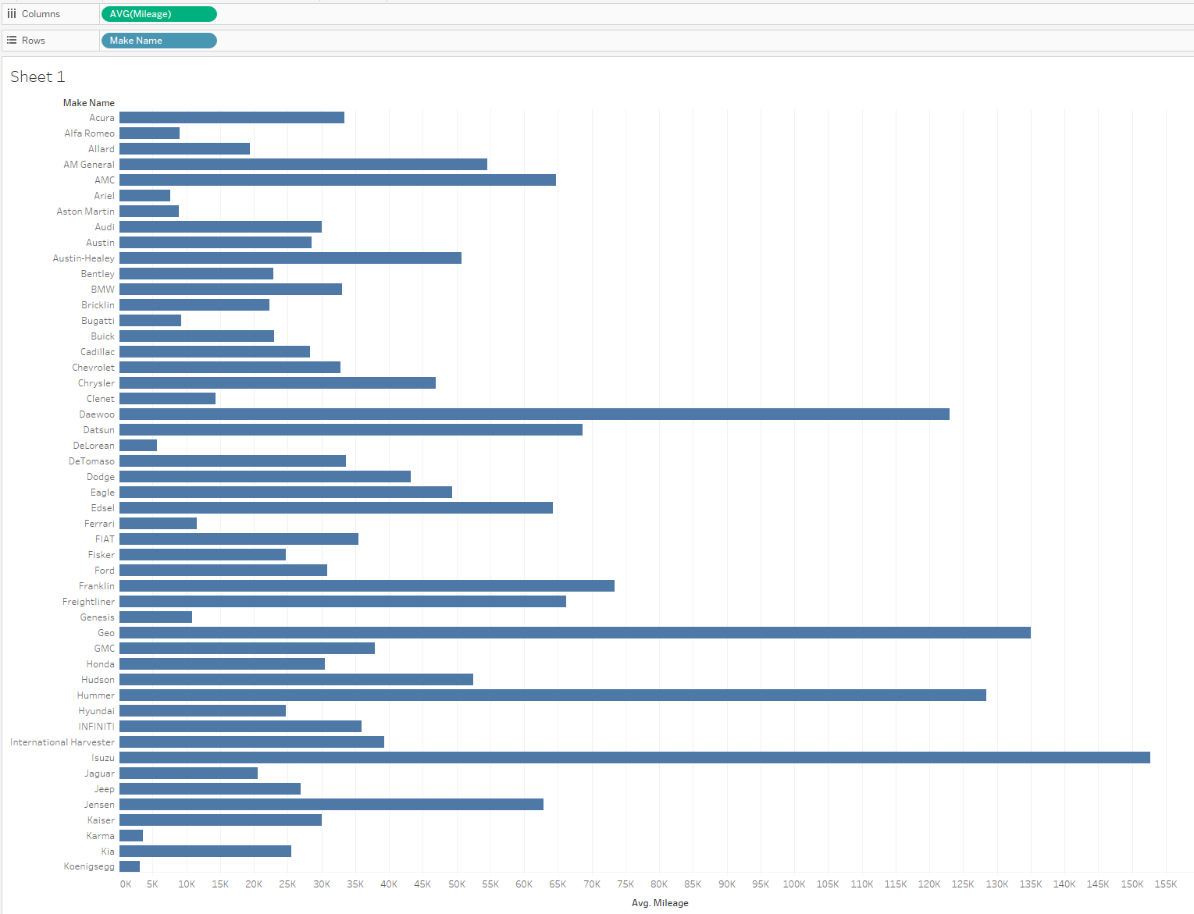
Average mileage by Make 1 (Tableau)
Isuzu cars generally have the most mileage. It should be noted that Isuzu primarily manufactures diesel worktructs.

Slide 18
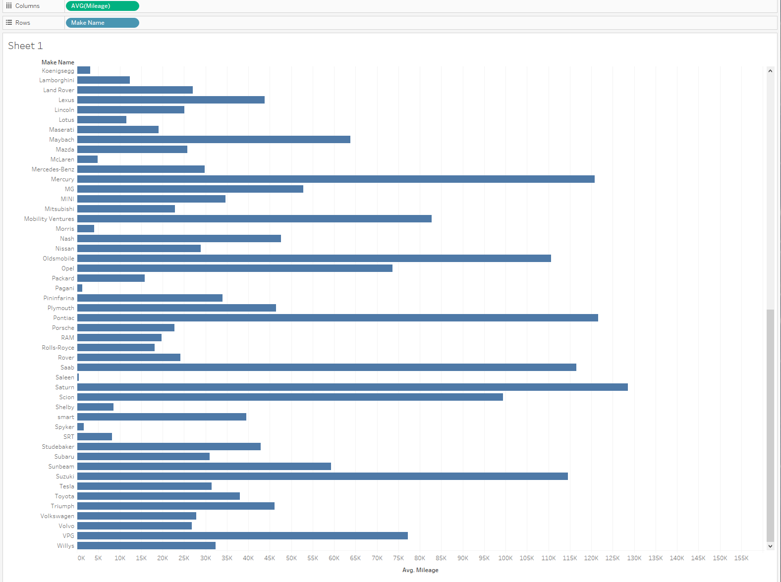
Average mileage by Make 2 (Tableau)

Slide 19
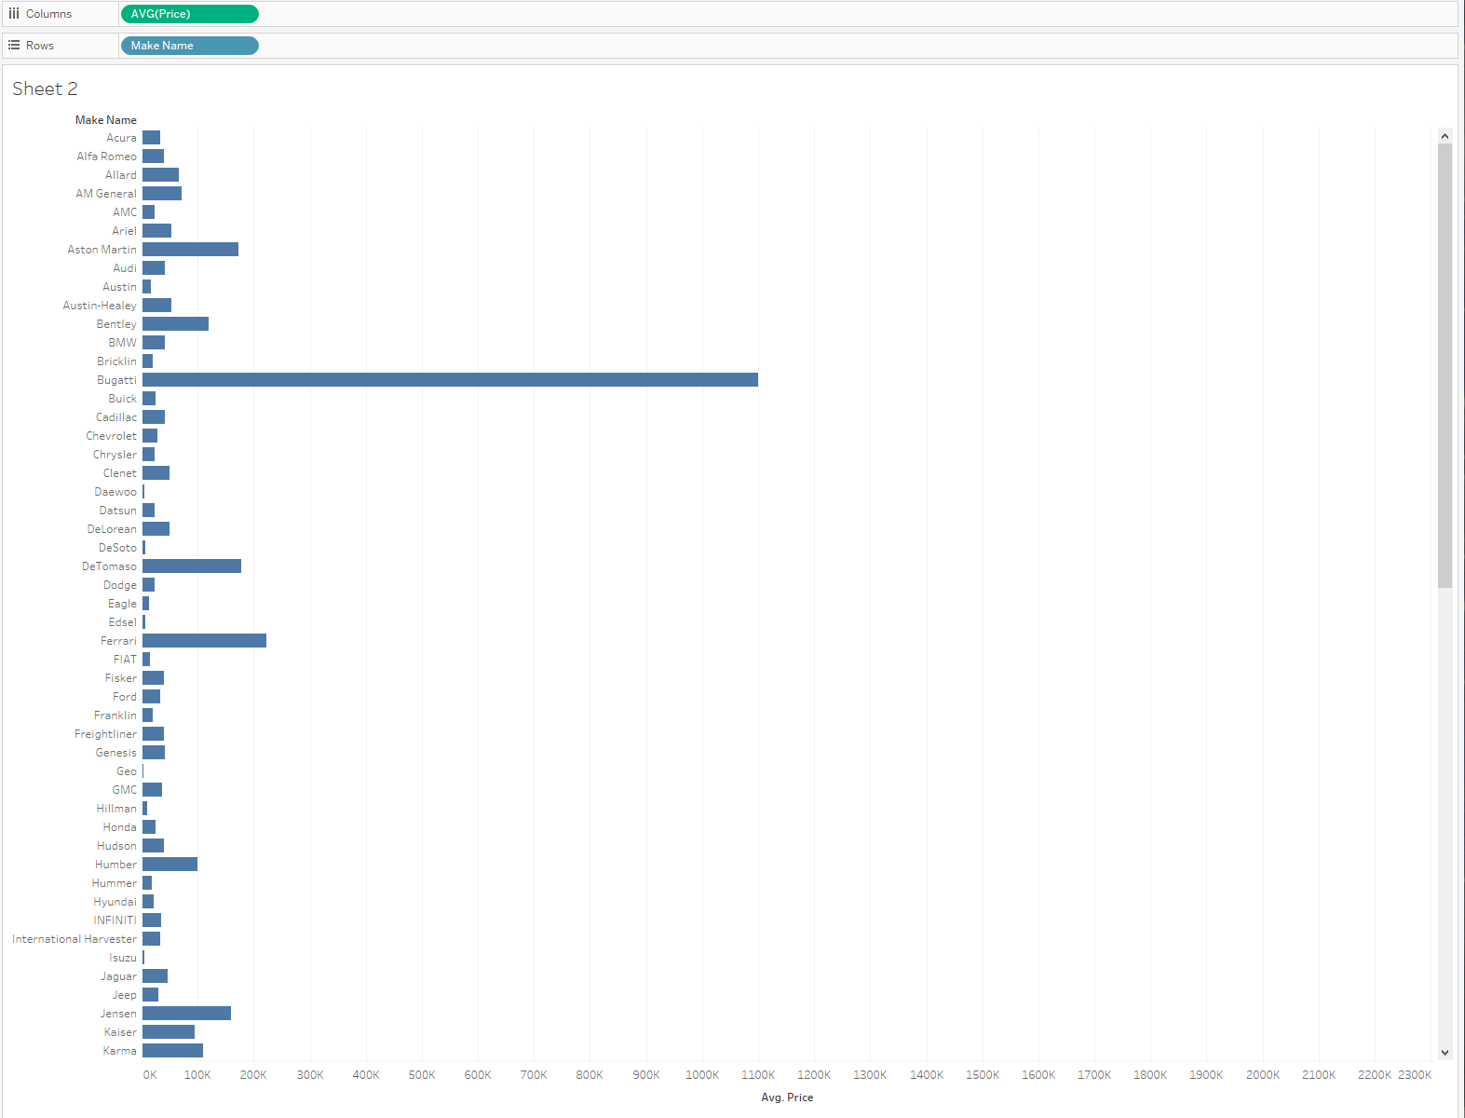
Average price by Make 1 (Tableau)
Japanese cars such as Suzuki, Honda, Toyota, and their sub brands are usually the lowest in average listing price.

Slide 20
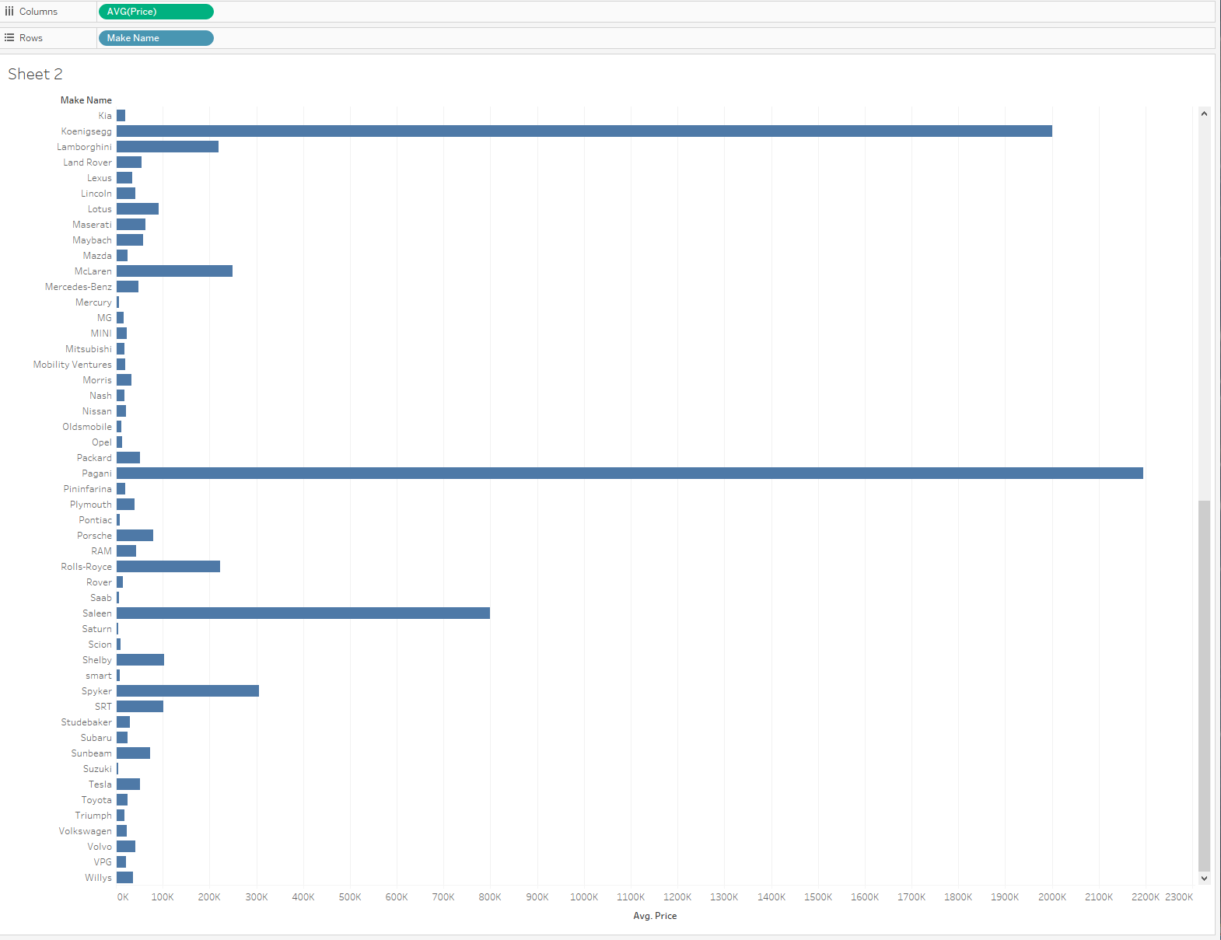
Average price by Make 2 (Tableau)
Not filtered prices

Slide 21
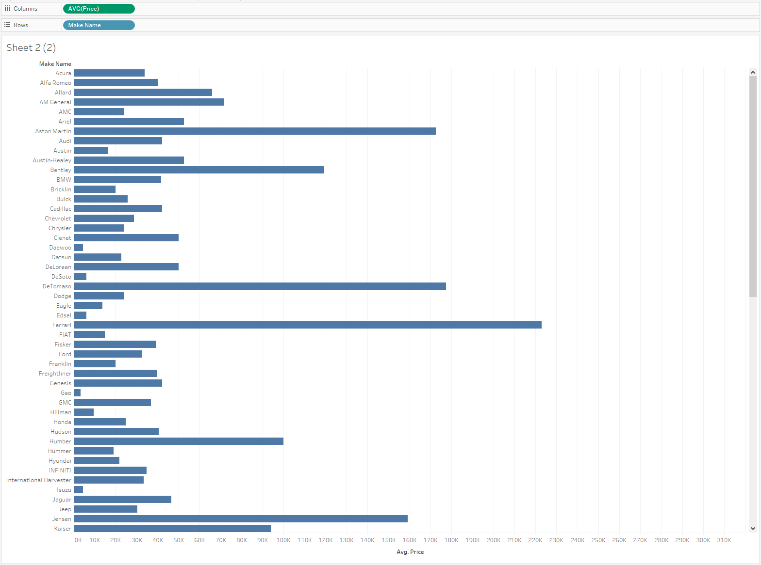
Make by filtered average price 1 (Tableau)
Filtered by average price higher than 500,000

Slide 22
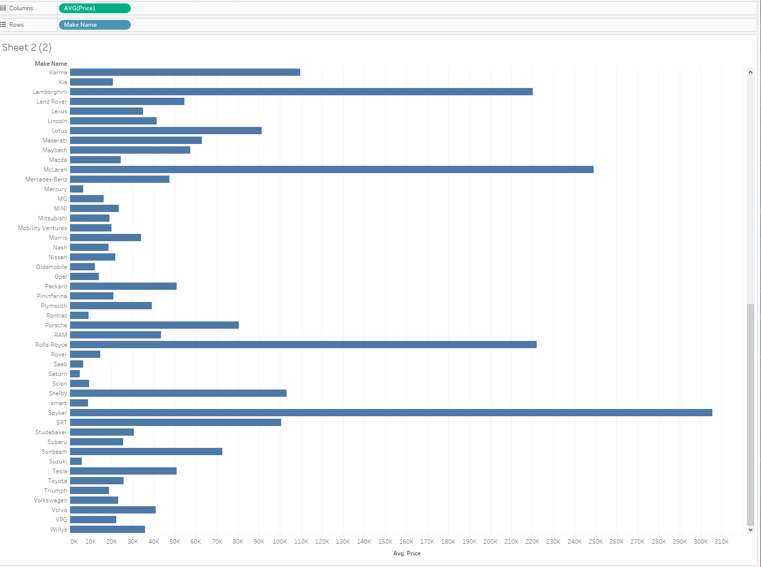
Make by filtered average price 2 (Tableau)
Filtered by average price higher than 500,000

Slide 23
Used Car Analysis (1)
At 2020 had the highest amount of used cars which may be a result due to COVID-19. Factories shut down and people stopped buying new cars.
Common used cars someone might see are Ford, Chevrolet, and Honda.
Used cars can be located in populated cities and in the east coast of the United States

Slide 24
Used Car Analysis (2)
Japanese cars notably Suzuki, Honda, and Toyota with their sub brands are averagely priced below 100k

Slide 25
Links
Github: https://github.com/aylmaokai/CIS4560
Direct Dataset Link: https://www.kaggle.com/ananaymital/us-used-cars-dataset
AWS Link: https://cis4560.s3.us-east-2.amazonaws.com/archive.zip

